Slide 1
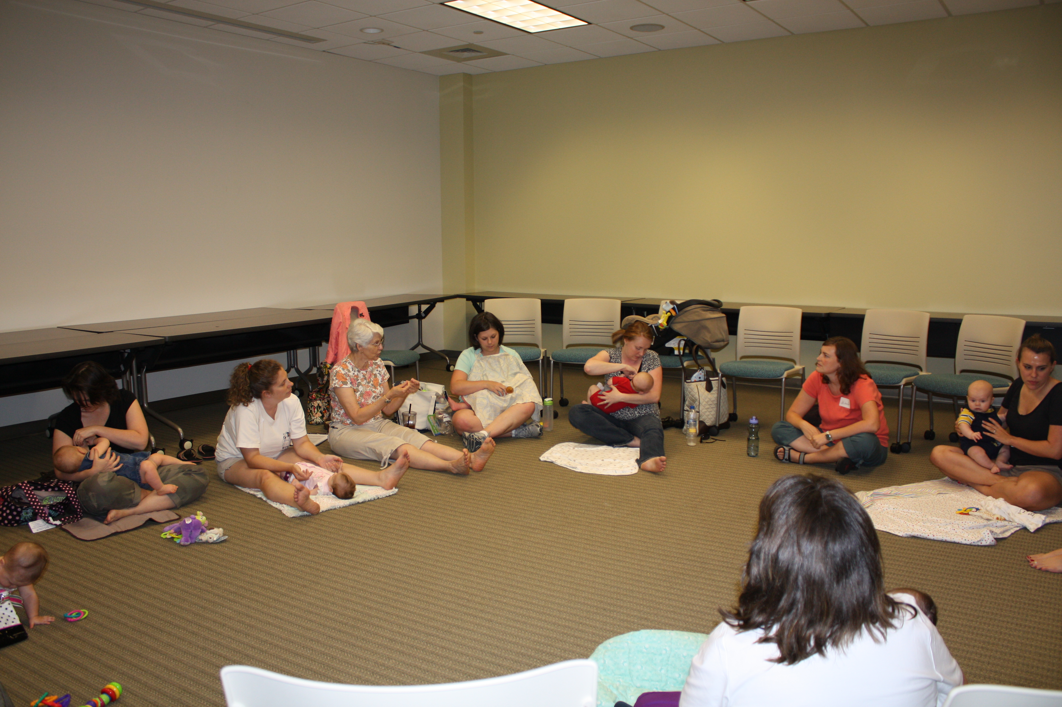
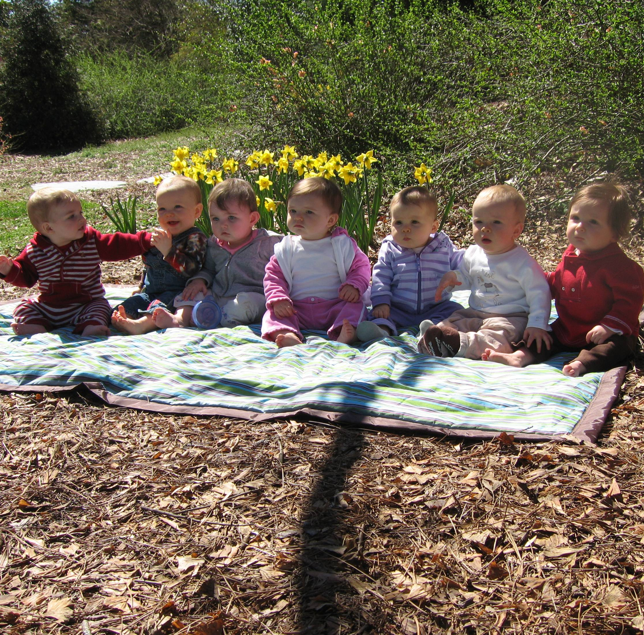
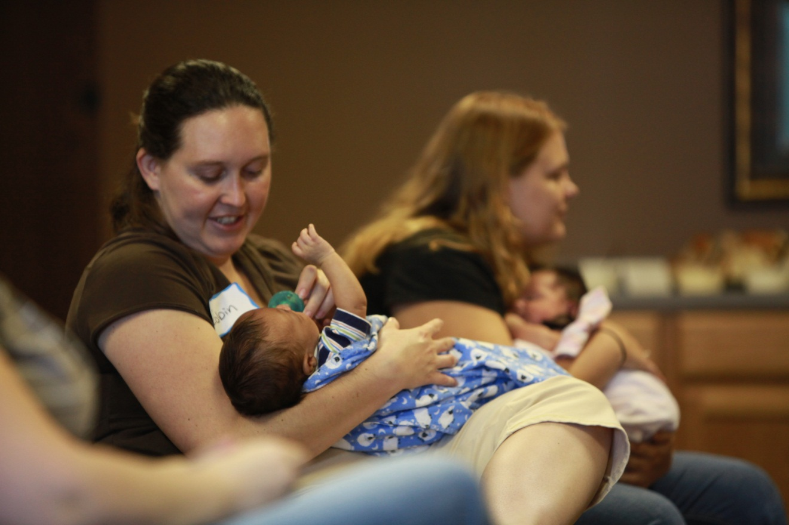
Developing Group Support for Breastfeeding Mothers:
An Overview of Three Models Used in NC
Barb Carder, RN, IBCLC; Joan Levy, EdS, MSN, RN, IBCLC; Mary Overfield, MN, RN, IBCLC (mary_overfield@yahoo.com);
Catherine Sullivan, MPH, RD, LDN, IBCLC
Nursing
Mothers
of Raleigh
Model: Volunteer-Led + Community Setting
Contact: Mary Overfield, MN, RN, IBCLC
Started: 1970
Organization: Non-profit 501(c)3
DESCRIPTION
Nursing Mothers of Raleigh (NMR) is a breastfeeding mothers’ group that provides telephone counseling via trained Counseling Mothers and hosts two public meetings each month, one in the morning and one in the evening. Meetings are open to any women interested in breastfeeding and their babies and children. Couples meetings are arranged upon request.
GETTING STARTED
It is very important to have more than 1 or 2 volunteers involved before you start a group. This provides adequate coverage to handle scheduling conflicts and also offers a variety of perspectives at meetings.
The physical setting must be public, comfortable, and familiar. Many Y’s and community centers have meeting facilities that may work.
Think through the logistics of the facility (diaper changing area; will you offer snacks/refreshments/toys; space for strollers and toddler play, etc...).
Limit time to 1 hour for content and allow time for Q&A and networking among mothers. Rotate topics but be prepared to teach what group needs.
Funding: We rent hospital-grade electric breast pumps and collect a cleaning fee to help with our costs. We also accept donations and sell a variety of items (personal pumps, t-shirts, note cards).
Advertising: community calendars; Meet-Up groups on the internet; posters in clinics, libraries, community centers; brochures to pediatricians.
CHALLENGES
Finding a free place to meet in order to be able to avoid having to charge dues. While it is true that people value what they pay for, even a small amount for membership dues can be a disincentive to attending meetings.
Providing information in the formats that mothers want. We found books, DVDs and handouts were not very useful so we made handouts available via our website (requires someone to create/maintain a website).
Maintaining a vigorous mother-to-mother support group. We found that a democratic organization of volunteers kept people involved long term.
Duke University
Health System’s
Teer House
Model: Health Care Professional Facilitation + Clinical Setting
Contact: Joan Levy, EdS, MSN, RN, IBCLC
Started: 2006
Organization: Part of hospital’s education services
DESCRIPTION
Feedback to this clinical facility indicated prenatal classes and education in the hospital regarding newborn care and breastfeeding were not providing enough information and support for mothers during the initial postpartum period. To this end, a multidisciplinary approach to meeting the needs of new mothers was developed with the end result of a free, open and ongoing support group/class for new mothers and their babies.
GETTING STARTED
Identify stakeholders: childbirth educators, lactation staff, new moms, nurses, pediatricians, physical therapists, social workers
Determine format: mom-to-mom interactions with support from seasoned participant “experts”
“Tell us one good thing that has happened since last meeting?”
“Who else has had similar issues and what did you do about it?”
Prepare to facilitate typical topics/group focus related to: breastfeeding, sleep issues, immunizations, relationship issues, etc.
CHALLENGES
Staff learning curve to not jump in with answers in order for group to truly becoming a mom-to-mom support group
Ability to have staff members from a variety of disciplines at each meeting
Initially unable to offer weekly meetings; weekly meetings initiated in 2011
BENEFITS
Mother
Baby
Foundation
Model: Certified Lactation Consultant Led + Community Setting
Contact: Barb Carder, RN, IBCLC
Started: 2007
Organization: Non-profit 501(c)3
DESCRIPTION
Mother Baby Foundation’s mission is to provide a prenatal and postpartum support network for new and expectant mothers. Programs focus on promoting optimal infant nutrition and breastfeeding, fostering healthy families by promoting the mother/baby bond, and supporting new mothers by encouraging emotional wellness. Mother Baby Foundation sponsors several programs including Triad Nursing Moms, PEP Talks, Teen Talks, and Baby Bundles.
GETTING STARTED
The 4 Ps of starting a support group:
Place – A very large, visible and centrally located medical building with easy access
People –
Seasoned professional, skilled at teaching & handling breastfeeding as well as baby care questions
Volunteer to pass out light snacks, make moms and babies comfortable; very supportive and encouraging of breastfeeding
Moms are allowed plenty of time for interaction and sharing
Promotion - MBF website, Facebook, doctors offices , health departments, and local hospital
Politics - Not being in competition with other support groups or health care providers
Normalization and understanding of universality of concerns
Lactation support during as well as before and after the official group session
Monthly Back to Work BF Group
Spinoff of “Getting in Shape with Baby” by PTs and “New Tools for New Dads” support group facilitated by a male pediatrician
Pediatric Residents reported increased awareness of and sensitivity to postpartum patients’ needs
CHALLENGES
Funding a breastfeeding support group:
Grants
Private donors
Fundraising
Managing your breastfeeding support group:
Advertising is forever!
Promote selected topics in advance
Communicate with speakers
Monitor and hold members and volunteers accountable
Creating a mommy/baby friendly atmosphere
“Getting to know you” time
Refreshments
Topics
Create opportunities for group questions as well as private concerns
Have fun & relax
.
Providing ongoing in-service training for our volunteers:
Monthly training taught by IBCLCs
Provide funding for volunteers to attend lactation conferences
Communicating that we care about each mother’s experience -- this is the most important factor in our success!
Long term relationships formed with cohort groups meeting on their own

